Slide 1
Introduction to Body Systems

Slide 2
By the end of this lesson, you should be able to:
Explain the difference between unicellular and multicellular organisms.
Recall the levels of organisation in a multicellular organism.
Explain how structure can be related to function in an organism.

Slide 3
So what are multicellular and unicellular organisms?
Unicellular organisms are organisms that consist of one cell only! This means that all of their life processes, such as reproduction, feeding, digestion, and excretion, occur in one cell.
Examples of unicellular organisms include pond water organisms such as Amoeba and Paramecium.
A tissue, organ or organism that is made up of many cells is said to be multicellular. Multicellular organisms consist of multiple cells.
Humans, animals and plants are all examples of multicellular organisms.

Slide 4
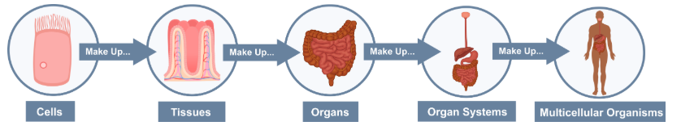
Remember that levels of organisation allow for complex processes to be controlled and coordinated in every cell of an organism.
Multicellular organisms are arranged in specific levels of organisation:
All multicellular organisms are made up of cells.
Similar cells group together to form tissues.
Tissues group together to form organs.
Organs group together to form organ systems.
All the organ systems together form the organism.

Slide 5
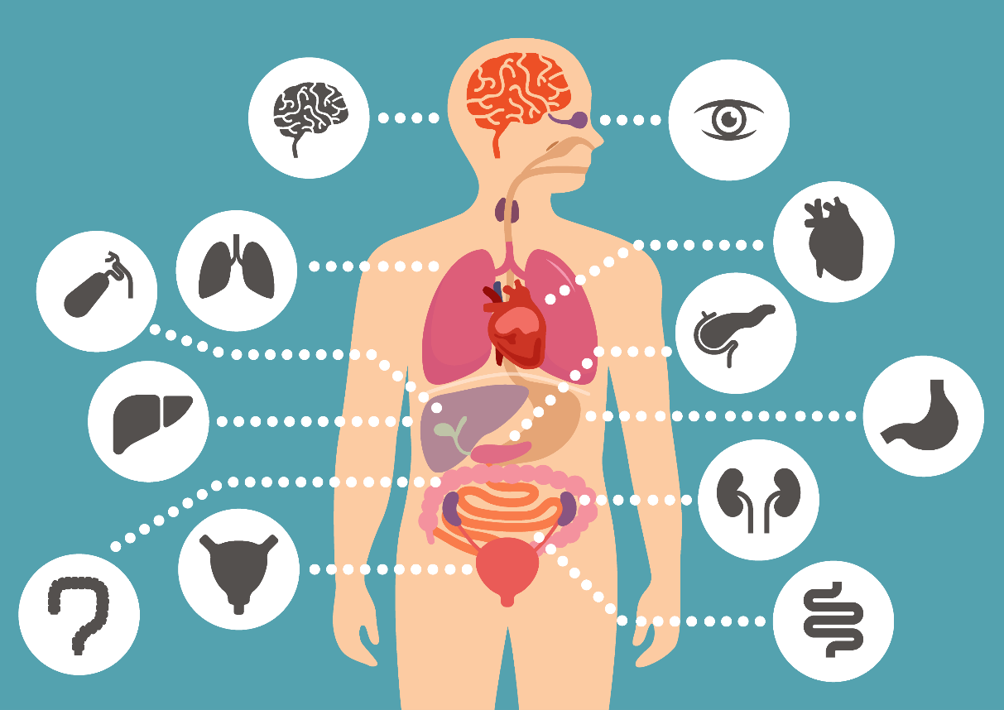
Structure describes what something is, whereas function describes what something does.
In biology, a key idea is that structure determines function. In other words, the way something is arranged enables it to play its role, or fulfil its job, within an organism.
Essentially, how something is shaped (its structure), is always closely related to its function!

Slide 6
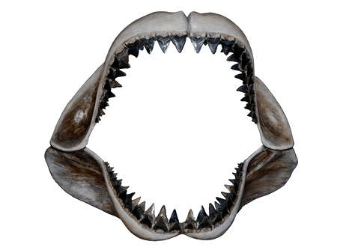
For example, the teeth of carnivores (animals that eat meat) are designed to easily cut through meat.
This is their function. To do this, they are sharp. This is their structure.
By looking at the sharp teeth of a shark below, you could safely assume that they are designed for cutting and tearing meat.

Slide 7
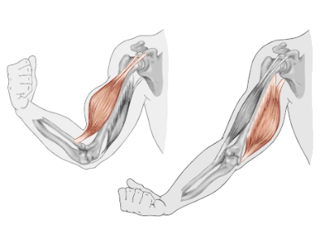
Muscle cells are capable of contracting (shrinking down) to half their resting size.
They contain lots of mitochondria, which provide the energy to do this.
This makes them very mobile cells, therefore they can change size a lot. You can probably guess their function: they allow us to move by pulling on our limbs.

